Slide 1



Slide 2
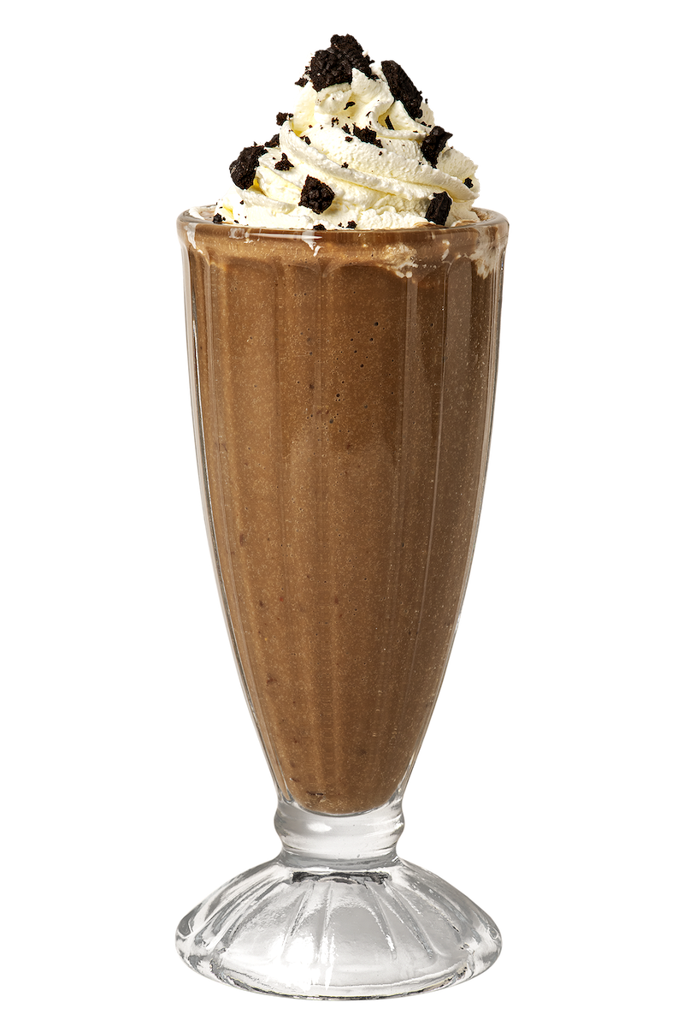
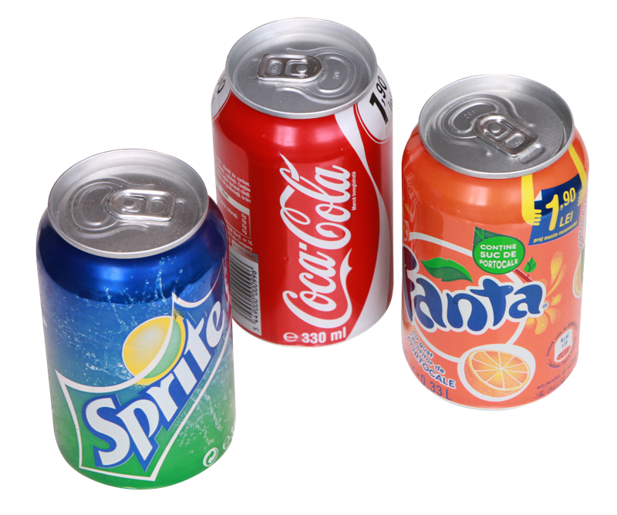
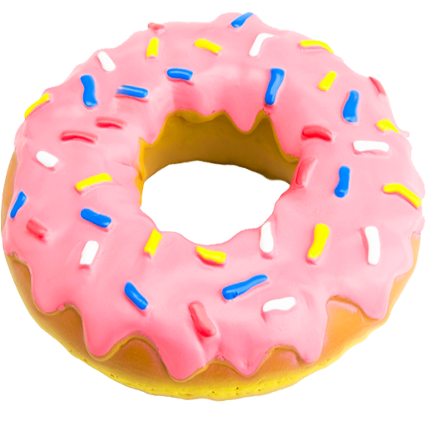
Sugary foods, drinks and industry tricks!
This Photo by Unknown Author is licensed under CC BY-NC

Slide 3
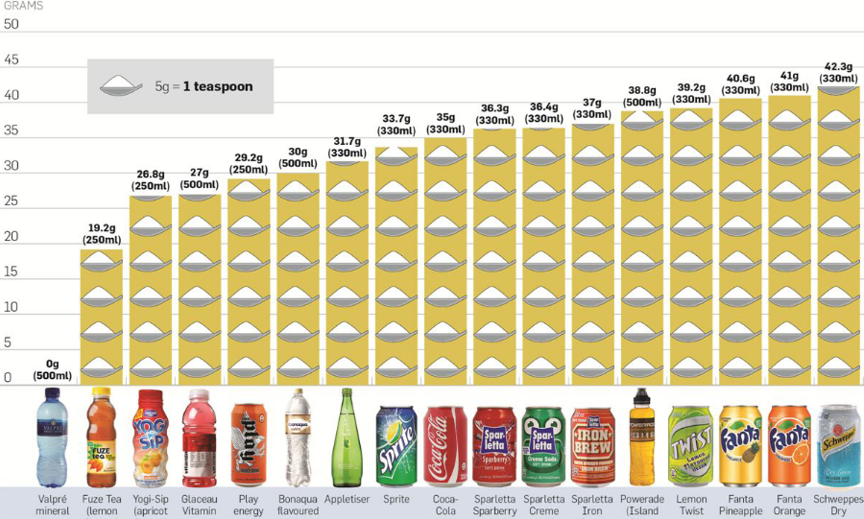
This Photo by Unknown Author is licensed under CC BY-SA-NC

Slide 4
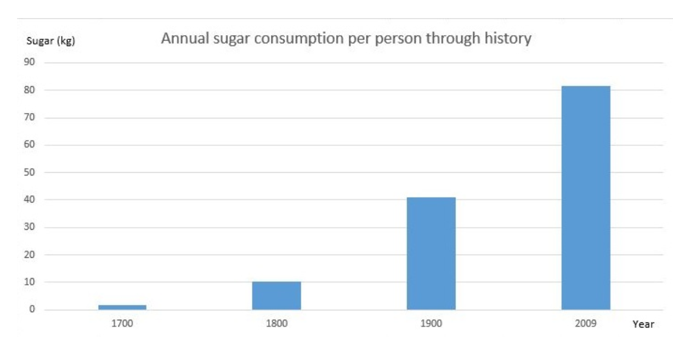
USA in 2009
NZ in 2009

Slide 5
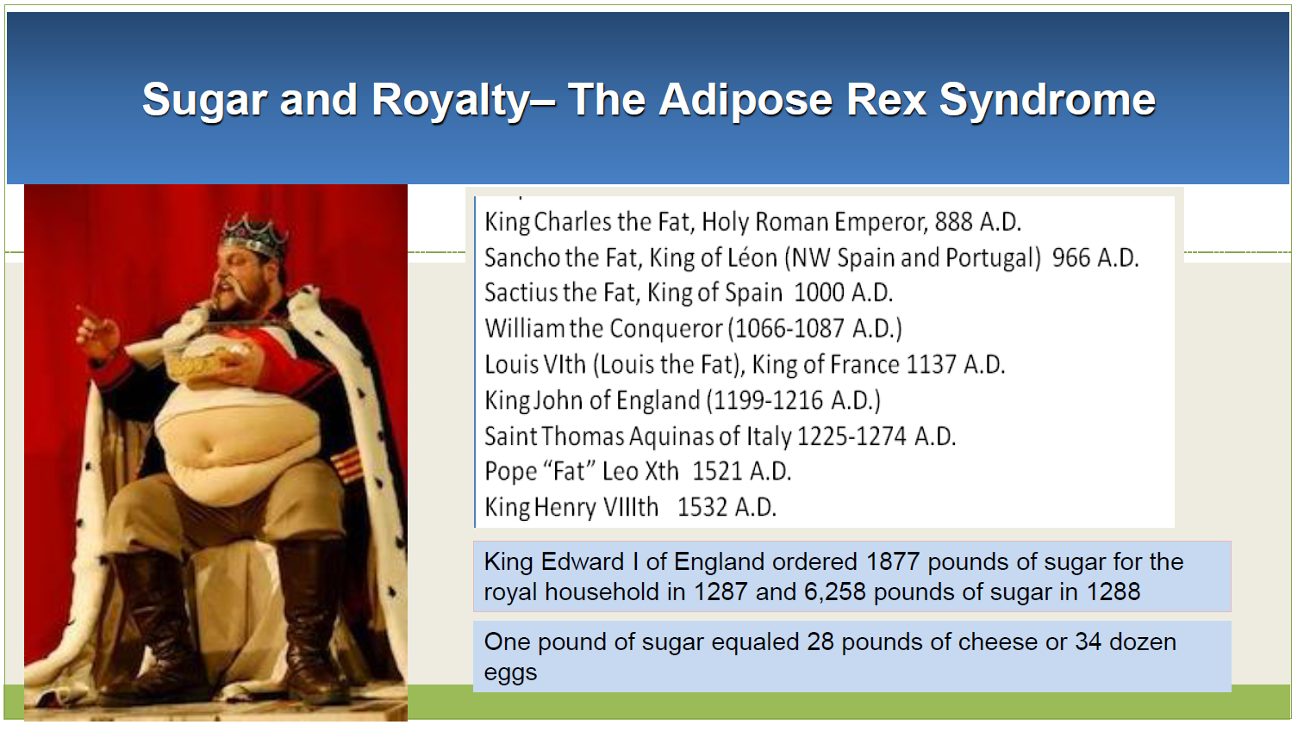

Slide 6
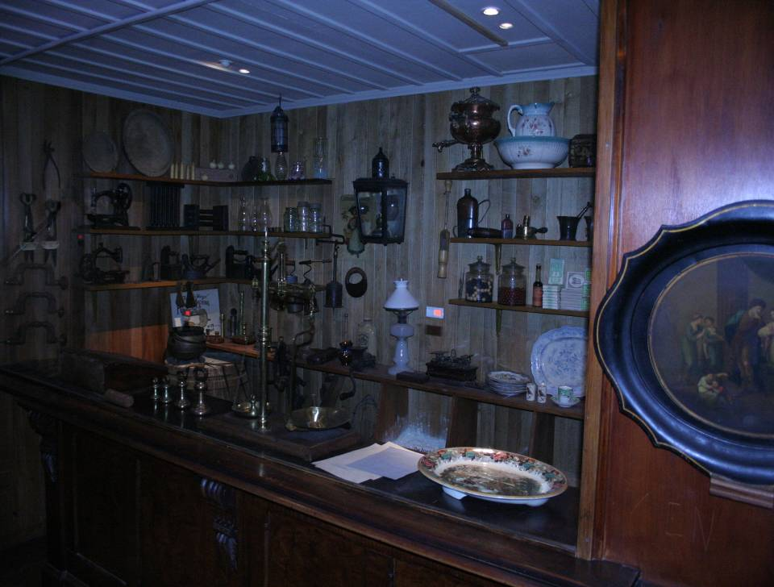
This is a shop from the 1800’s
Do you think there is
much
SUGAR
here?

Slide 7
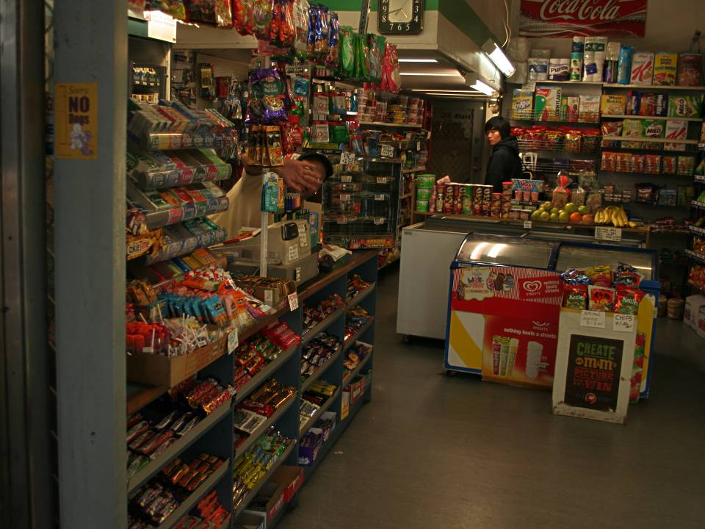
Here is a shop today
Do you think there is
much
SUGAR
here?
Dairy photo
Notes:
This is a sugar palace, no sorry, it’s a dairy. Hard not to find anything not containing sugar. Even the cigarettes behind the counter are over 10% sugar.

Slide 8
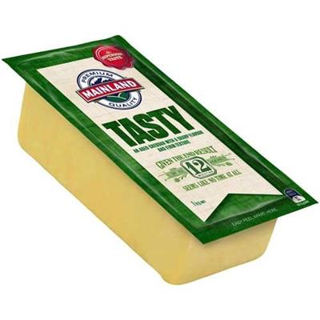

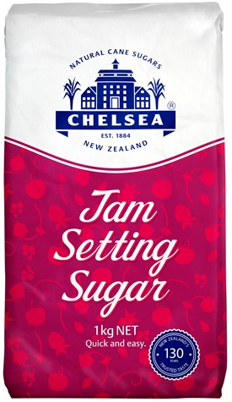
The Cost of Sugar
1700
Today
1 kg sugar
14 kg Cheese
1.5 kg sugar

Slide 9
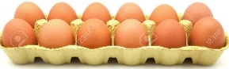
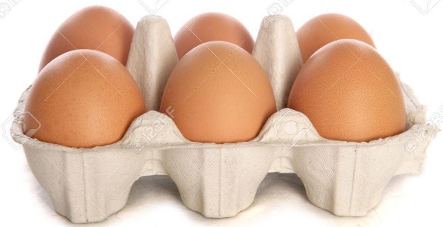

The Cost of Sugar
1700
Today
1 kg sugar
34 dozen eggs
1/2 dozen eggs

Slide 10
Play Video here – Hugh Jackman, History of Sugar

Slide 11
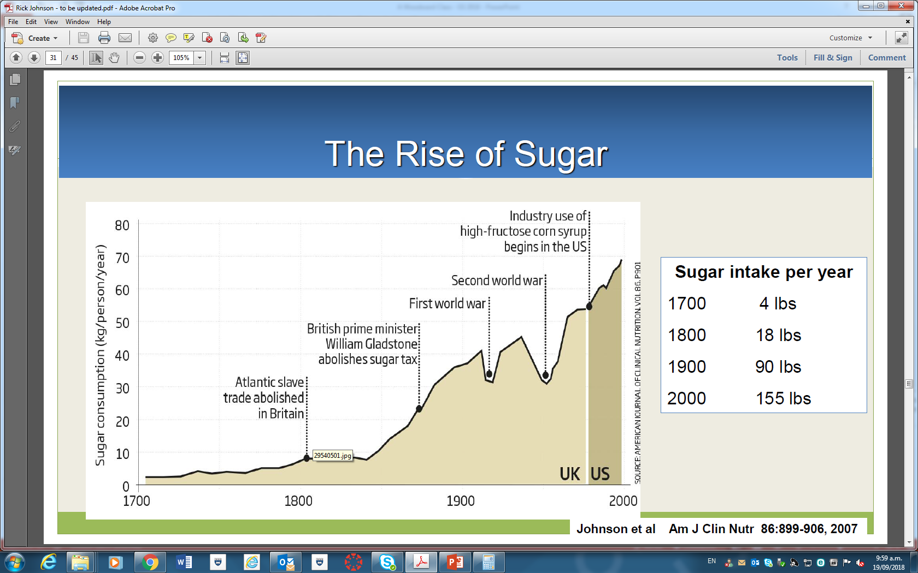
NZ
= 2 kg per year
54kg
= 8 kg per year
= 40 kg per year
= 70 kg per year
President of USA had a heart attack, Professors Ancel Keys & John Yudkin argued of the main cause – Fat became the #1 target.

Slide 12
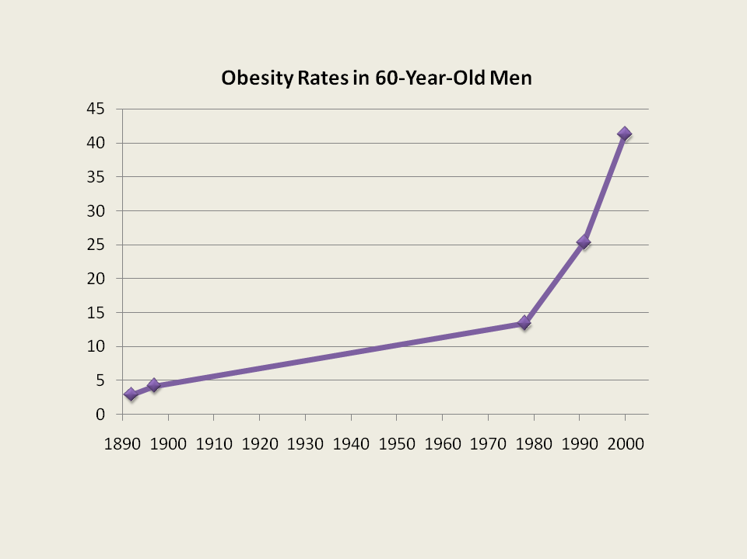
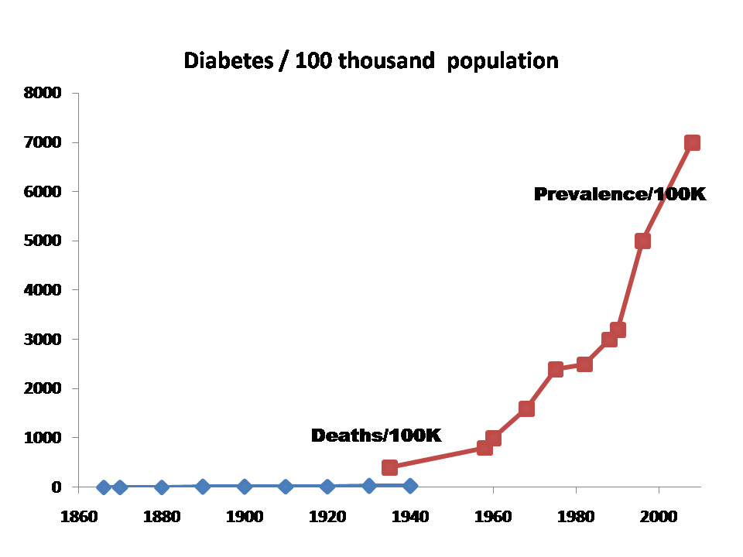
Obesity and Diabetes: The Twin Epidemics
One in three adults are obese
One in nine adults are diabetic
One in 30 adults are obese
One in 50,000 adults are diabetic
Johnson et al Am J Clin Nutr 2007

Slide 13
Unhealthy Weight
Diabetes
Sugar Intake
Johnson et al Am J Clin Nutr 2007

Slide 14
Notes:
This 3-6-9 logo was developed to explain the maximum number of teaspoons of sugar a child (3), woman (6) and man (9) can have each day.

Slide 15
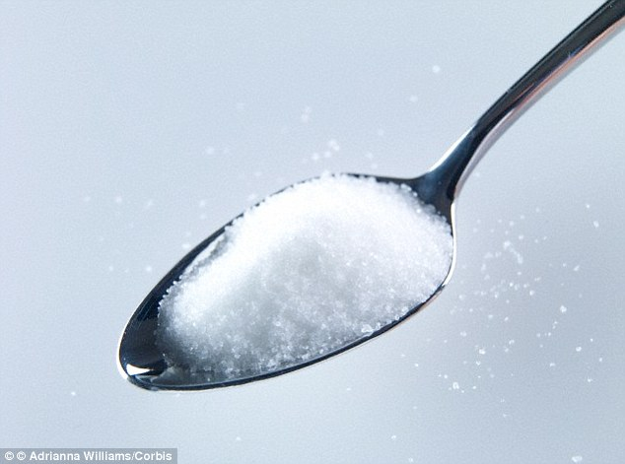
= g
4
A teaspoon of SUGAR
Notes:
There are 4 grams of sugar in 1 teaspoon.
You need to now this to calculate sugar content of products into teaspoons.

Slide 16
